Slide 1

18. Personal Identity
Session V: Mental and Physical Health

Slide 2
Chapter outlines
Assessing Your Values
Stages of Life
Student Responsibilities
College vs. High School

Slide 3
LEARNING OBJECTIVES
By the end of this section, you will be able to:
Identify personal values and align them with educational goals
Use personality tests and/or skills inventories to evaluate career paths that match your values and interests
Describe the responsibilities of college student life and how they differ from high school or early career life

Slide 4
Man’s main task in life is to give birth to himself, to become what he potentially is. The most important product of his effort is his own personality.
—Erich Fromm, psychologist

Slide 5
Assessing Your Values
Your personal values are your core beliefs and guiding principles. They shape the roles you play in daily life.
Your values are a compass that help you make decisions and choices.
What are your values, then?
Which are most important to you, and which are least important?
How do your values fit into your educational goals?
How do your educational goals relate to your future career?

Slide 6
ACTIVITY: ASSESS YOUR PERSONAL IDENTITY AND VALUES
1. ISEEK Career Cluster Interest Survey:
https://careerwise.minnstate.edu/careers/clusterSurvey
2. Values Clarification Questionnaire:
http://www.theinsite.org/me/my_way/values_questionnaire_alias.html

Slide 7

Stages of Life
Keep in mind that your personal values and interests can and do change as you get older.

Slide 8
For example
College students, ages 18–26, tend to make choices that are tentative (more short-range) and support a desire for autonomy.
During ages 27–31, young adults may rethink decisions and lean toward more permanent choices.
In ages 32–42, adults tend to have a greater sense of commitment and stability, as shown by their choices.

Slide 9
Student Responsibilities
Research has shown that students who get involved in career-planning activities stay in college longer, graduate on time, improve their academic performance, tend to be more goal focused and motivated, and have a more satisfying and fulfilling college experience.
This is why an important first step in college is examining your personal identity and values.

Slide 10
Student Responsibilities
Step 1: examining your values
Step 2: is the importance of committing to your responsibilities as a student.
Expectations for student behavior vary from campus to campus.
What are your new student responsibilities?
Are they financial?
Course specific?
Social?
Health related
Ethical?
What exactly is expected of you?

Slide 11

Overall, you demonstrate that you are a responsible student when you do the following:
Uphold the values of honesty and academic integrity.
Arrive on time and prepared for all classes, meetings, academic activities, and special events.

Slide 12
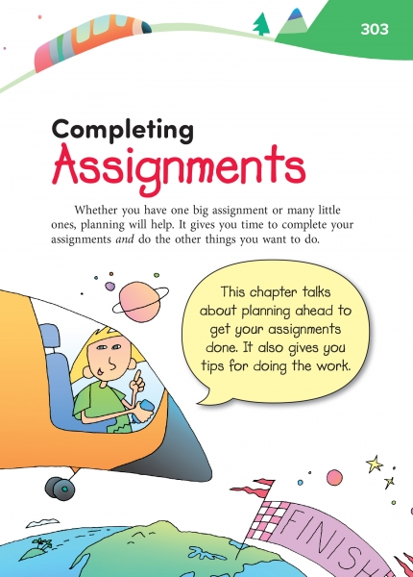
3. Give attention to quality and excellence in completing assignments.
4. Allot sufficient time to fulfill responsibilities outside of class.

Slide 13

5. Observe etiquette in all communications, giving respect to instructors, fellow students, staff and the larger college community.
6. Take full advantage of college resources available to you.
7. Respect diversity in people, ideas, and opinions.

Slide 14

8. Achieve educational goals in an organized, committed, and proactive manner.
9. Take full responsibility for personal behavior.
10. Comply with all college policies.

Slide 15

College life differs
in many ways
The following video clip is a brief, informal student discussion about the challenges you may face as a student and provides examples of issues students face in transitioning from high school to college.
“What are the two main problems identified in the video?

Slide 16


